Slide 1

ITS61504 DATA MINING
Group Assignment 3
Machine Learning-Based Prediction of FIFA World Cup Match Results
GROUP MEMBERS
0370716
Li Zhe
Bachelor of Computer Science
Gu Sijia
0365826
Bachelor of Business
Liu Yifan
Bachelor of Computer Science
0374114

Slide 2
Q1 | INTRODUCTION & PURPOSE
Turning football history into
World Cup outcome predictions
≈5B
fans reached by
Qatar 2022
PREDICTION TARGET
HOME WIN / DRAW / AWAY WIN
Historical results reveal team form and scoring patterns.
Data mining converts those patterns into predictive features.
The model supports analysis — it does not guarantee exact results.
Sources: FIFA (2023); Beal et al. (2020); Al-Bustami & Ghazal (2025)

Slide 3
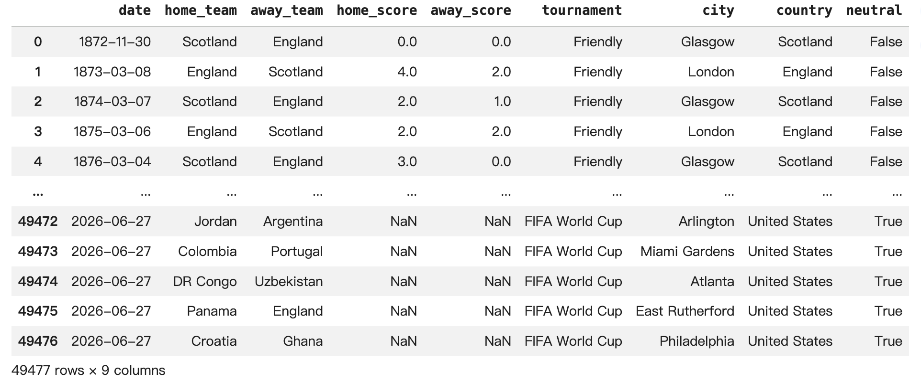
Q2 | DESCRIPTION OF DATA
49,477 matches cover international football from 1872 to 2026
CSV
structured table
9 fields
date · teams · scores
tournament · location · neutral
1872–2026
completed matches train the model;
unplayed fixtures are excluded
Each row represents one match; home_score and away_score define the three-class target.
Data types: date, categorical fields, numeric scores, and Boolean neutral venue.
Source: International Football Results (Jürisoo, 2026), Kaggle

Slide 4
Q3 | DATA PROBLEMS & PRE-PROCESSING
Raw match records became 23 leakage-safe predictors
KEY DATA PROBLEMS
PRE-PROCESSING
Unscored future fixtures
Not valid as completed training records
01 Standardize dates and sort chronologically
Fragmented tournament labels
02 Consolidate tournaments into four categories
Too many categories for consistent modelling
03 Build targets and five-match rolling features
No direct team-form variables
Win/draw rate · goals for/against · goal difference
Raw rows did not express recent strength
04 Compare home and away team form
Cold-start and class imbalance
Sparse team history and fewer Draw outcomes
05 Treat cold starts, encode categories and validate
1,680 → 0
missing engineered values after treatment

Slide 5
Q4 | DATA MINING TECHNIQUES
Three classifiers test different assumptions about outcomes
TECHNIQUE
Supervised
multi-class
classification
MODEL ROLES
Logistic Regression
Simple, interpretable baseline
Decision Tree
Captures non-linear rules and feature interactions
WHY NOT OTHER TECHNIQUES?
Labels were already known, so clustering was unnecessary.
The goal was prediction—not Apriori association rules.
Random Forest
Improves stability and exposes feature importance
All three models used the same engineered feature set for a fair technique comparison.

Slide 6
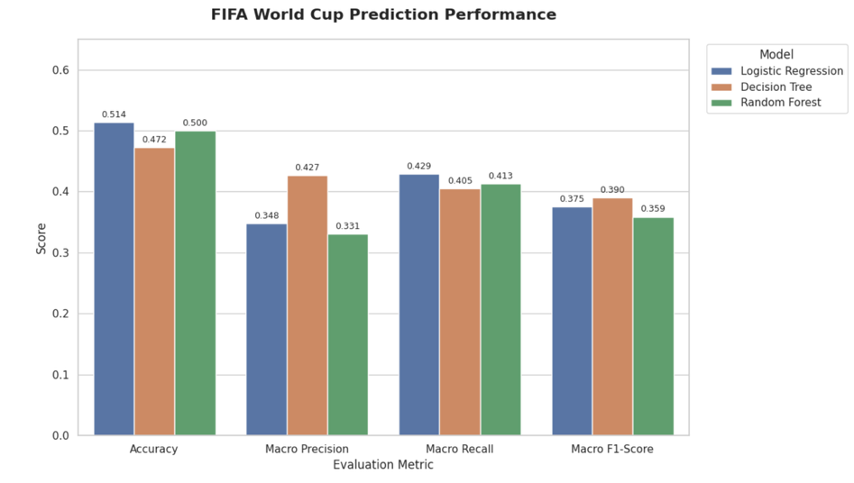
Q5 | MODEL VALIDATION
Three models were evaluated using chronological match data
FINAL MODEL
Decision Tree
0.3903
World Cup macro F1
highest of the three models
Draw F1 0.2133
The only model that meaningfully
recognized World Cup draws.
Decision Tree was selected because it achieved the highest World Cup macro F1-score and was the only model to identify draws.

Slide 7
Q6 | CONCLUSION & FUTURE IMPROVEMENTS
Historical data helps, but football remains hard to predict
KEY CONCLUSION
NEXT IMPROVEMENTS
Decision Tree offers the most balanced performance—not the highest accuracy.
01 Richer context
Rankings, injuries, line-ups and betting odds
02 Better optimization
Historical form and team comparisons provide useful signals.
Draw remains the hardest outcome to classify.
Tactics, injuries and match pressure limit predictability.
Current features cannot fully capture real-time match conditions.
Grid search or random search
03 Stronger models
Boosting, XGBoost and ensemble stacking
04 Class balance & validation
Priority: improve Draw recognition without sacrificing class balance.
Handle class imbalance and apply rolling-window validation.

